Slide 1
Nanocomposites
Composite materials are made from two or more materials with significantly different physical or chemical properties, that when combined, produce a material with characteristics different from the individual components.
The individual components remain separate and distinct within the finished structure.
There are four types:
1. Fibrous composites (fibers in a matrix)
Continuous fibers, woven fibers, chopped fibers
2. Laminated composites (layers of various materials)
3. Particulate composites
4. Combinations of some or all of the above

Slide 2
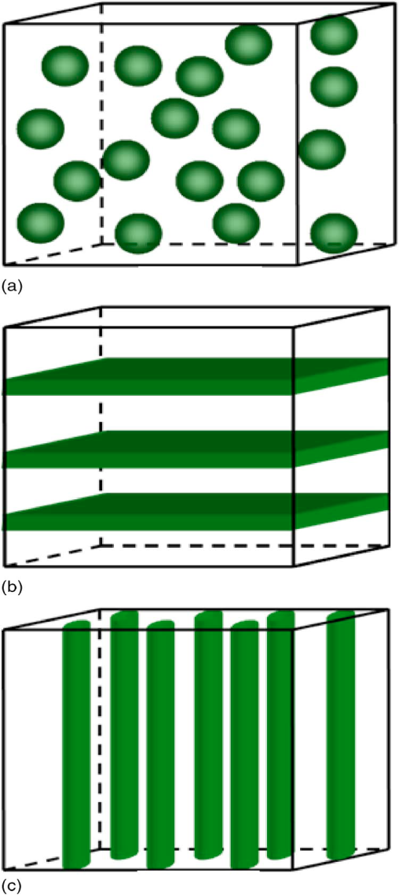
Color online Schematic illustration of three composites with the three common connectivity schemes: (a) 0–3 particulate composite, (b) 2–2 laminate composite, and (c) 1–3 fiber/rod composite.

Slide 3
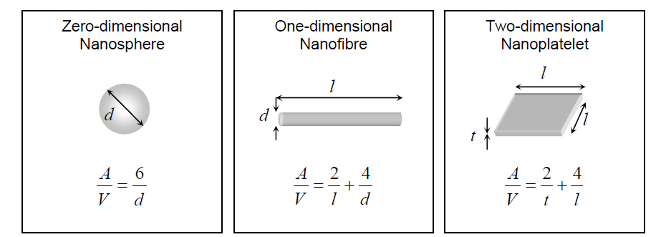
Nanocomposites consist of a nanometer-scale phase in combination with another phase. In terms of nanofiller dimensionality, they can be classified as zero dimensional nanosphere), one-dimensional (nanofibre), two-dimensional (nanoplatelet), and three-dimensional (interpenetrating network) systems
Surface area/volume (A/V) relations for various reinforcing geometry
d is the particle or fibre diameter,
l -> fibre or platelet length
t ->platelet thickness
homogeneous nanocomposite should be created more easily using nanofibres rather than nanoplatelet

Slide 4
Advantages of Nanosized Additions
Mechanical properties e.g. strength, modulus and dimensional stability
Decreased permeability to gases, water and hydrocarbons
Thermal stability and heat distortion temperature
Chemical resistance.
Surface appearance
Electrical conductivity
Magnetic property
Optical clarity in comparison to conventionally filled polymers

Slide 5
Disadvantages of Nanosized Additions
Impurity
Cracks.
Toughness and impact performance

Slide 6
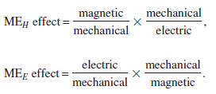
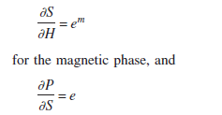

Let us take one EXAMPLE
Multiferroics
Similarly enhancement of dielectric property, magnetic property, electrical transport etc.
If a magnetic field is applied to these material
for the piezoelectric phase; where S is the strain and e^{m} and e are, respectively, piezomagnetic and piezoelectric coefficients. As a result, this two-phase composite material can be
characterized by
where k_{c} is a coupling factor 0≤k_{c}≤1 between the two
phases and is the ME coefficient of the composite.
a new property i.e., nonzero ME coefficient appears in the composite consisting of magnetic and piezoelectric phases, since neither constituent phase is magnetoelectric. This new ME product response is due to elastic coupling between the two constituent phases. High piezomagnetic and
piezoelectric coefficients and strong coupling large kc favor a large ME coefficient.

Slide 7
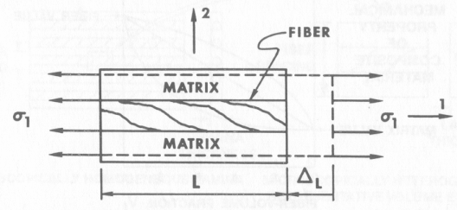
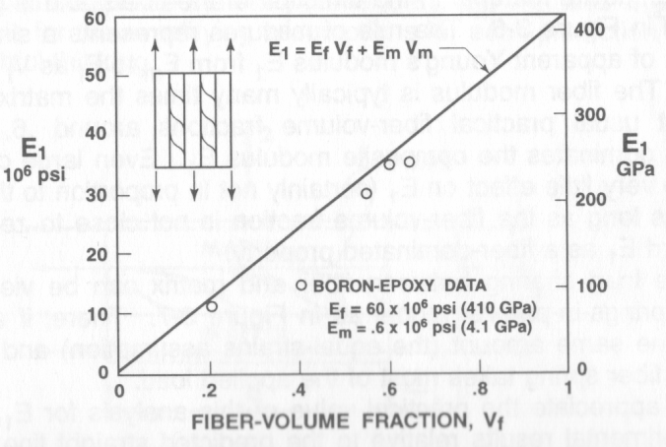
Stiffness E₁ (Rule of Mixtures)
MATRIX
fiber
MATRIX

Slide 8
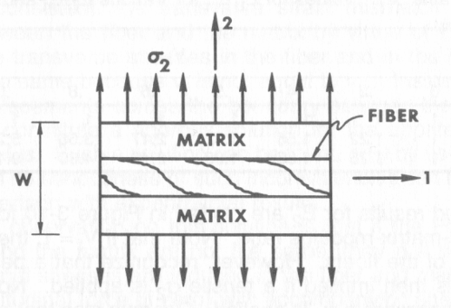
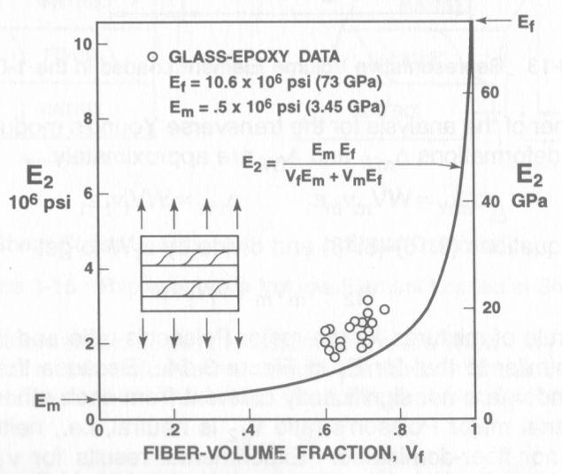
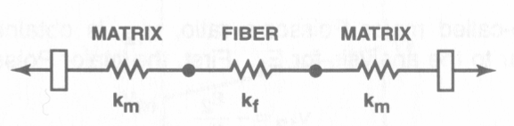
COMPOSITE
Stiffness E₂ (Rule of Mixtures)
MATRIX
fiber
MATRIX
Stiffness ν₁₂ and G₁₂

Slide 9


For composites in which discontinuous fibres are not perfectly aligned, two parameters need to be incorporated in equation, the length efficiency factor(η_{L} ) and the orientation factor(η₀)
The fibre length efficiency factor η_{L} can vary between 0 and 1
The orientation factor η₀ is equal to 1 for fully aligned fibres
3/8 for random two dimensional orientation
1/5 for three dimensional orientation
A similar equation is valid for strength,

Slide 10
Strength prediction: In general, relations for predicting strength are complex. However, for randomly oriented fibers, an approximate equation may be used to estimate the tensile strength, as follows (Gibson, 2007):

Slide 11
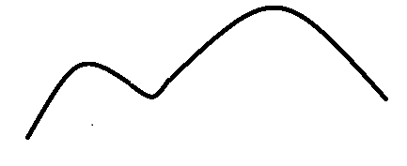
LET US NOTE DOWN DIFFERENCES BETWEEN COMPOSITE AND NANOCOMPOSITE
Nanocomposite:
~ 10% filler compare to the matrix (polymer, ceramic, metal etc.)
Strength of Matrix definitely increase, similar to other properties.
Composite:
Any combination
Strength of Matrix may or may not increase. Similar to other properties.

Slide 12

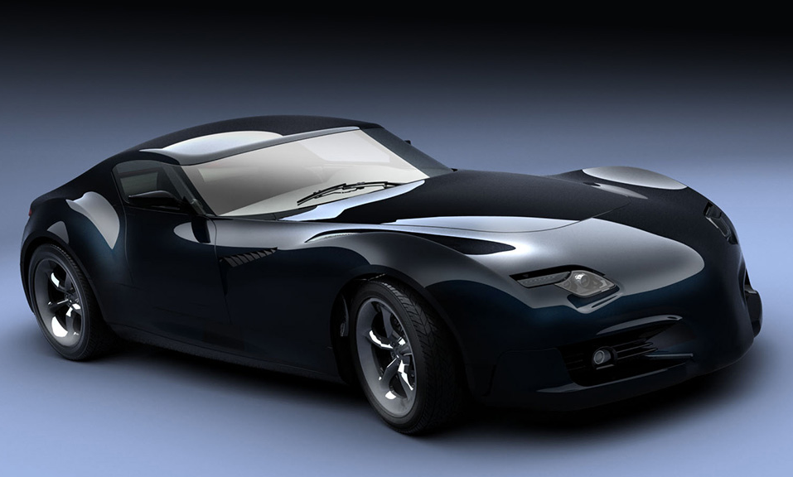
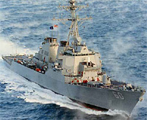
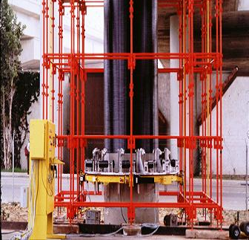
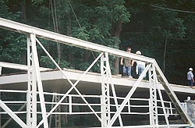
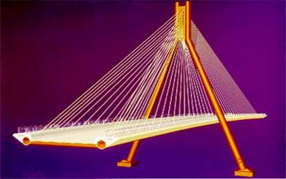
Engineering Applications:
1. Composite materials or nanocomposite have been used in aerospace, automobile, and marine applications
2. Composite materials in civil engineering structures
3. seismic retrofit of bridge columns, replacements of deteriorated bridge decks, and new bridge structures.

Slide 13
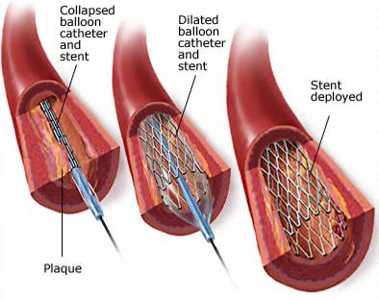
Medical Applications:
Stents are made with steel or with polymers with shape memory effects
(The material is deformed within a temperature range of glass transition temperature (Tg) of amorphous phase and melting temperature (Tm) of crystalline phase, then was cooled below Tg. After the material was reheated between Tg and Tm, the original structural shape was recovered)

Slide 14
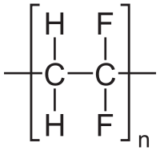
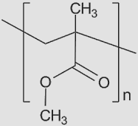
Why Polymer?
Flexibility.
Easy processing.
Low weight.
Relatively high electrical breakdown strength(≈ 100MV/cm) as compare to ceramic (10-100kV/cm).
H
CH₂
C
OH
n
Polyvinylidene Fluoride
[PVDF]
Polyvinyl Alcohol
[PVA]
Poly(methyl methacrylate)
[PMMA]
Melting Point: 178ºC
Density : 1.78 g/cm³
Melting Point: 200ºC
Density : 1.19 g/cm³
Melting Point: 160ºC
Density : 1.18 g/cm³
Chemical structure of the different polymers a) PVDF b) PVA and c) PMMA

Slide 15
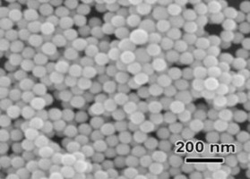
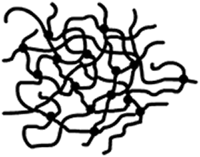
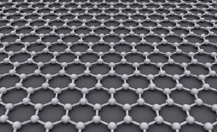
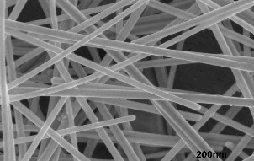
Introduction to Polymer Nanocomposite
Combination of a polymer matrix and inclusions (filler) that have at least one dimension (i.e. length, width or thickness) in the nanometre size range.
Nanoparticles (3D)
Nanosheets (2D)
Polymer Network
Nanowire (1D)
Progress in Materials Science 57 (2012) 724–803

Slide 16
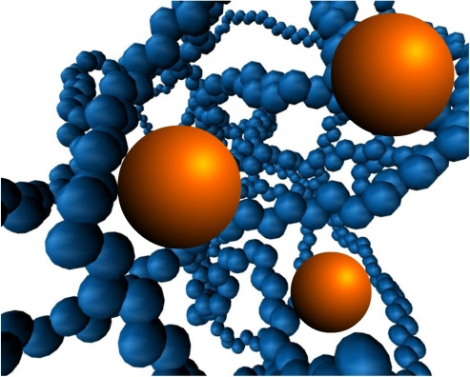
Advantage of Ceramic-Polymer nanocomposite
Advantages
Low filler loading.
Large surface area.
Without sacrificing the density, flexibility .
Enhance the physical and chemical properties.
Polymer nanocomposite
Several issues need to be address
Physical dispersion
Optimization of nanofiller to matrix ratio under percolation threshold limit.
Shape and size of nanofillers
Fabrication processes.
Type matrix (polymer) and filler (nanoparticle)
Scientific Reports 6, (2016), 26198, Journal of Alloys and Compounds 551 (2013) 200-207

Slide 17
Role of nanomaterial- polymer interface in nanocomposites
Enhance the interface area in nanocomposite due to nanosize filler, which leads to
Improve polarization and polarizability at the interface
PLASMONIC EFFECT OF NANOMATERIAL
Alter the electrochemical and electromechanical properties .
Matrix
Nanofiller
Interphase
Schematic diagram of nanocomposite

Slide 18
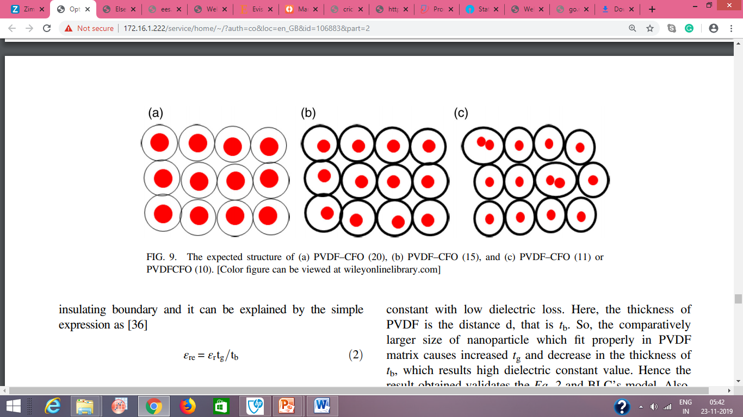

Slide 19
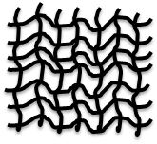
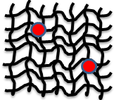
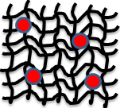
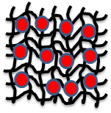
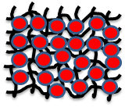
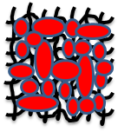
a
b
c
e
d
f
Expected structure and BLCs model of (1-x) PVDF(x)-BHF for x= (a) 0.00, (b) 0.025, (c) 0.05, (d) 0.15, (e) 0.30 and (f) 0.50.

Slide 20
Applications of Polymer nanocomposites
Environmental remediation
Energy harvesting & storage
Novel Catalysts
Polymer nano-
Composites
Information Industry
EM Radiation
absorption
Sensing & Actuation
Defense sector
Transportation & safety
Different applications of Polymer nanocomposite

Slide 21
Why Polymer?
Flexibility.
Easy processing.
Low weight.
Relatively high electrical breakdown strength(≈ 100MV/cm) as compare to ceramic (10-100kV/cm).
H
CH₂
C
OH
n
Polyvinylidene Fluoride
[PVDF]
Polyvinyl Alcohol
[PVA]
Poly(methyl methacrylate)
[PMMA]
Melting Point: 178ºC
Density : 1.78 g/cm³
Melting Point: 200ºC
Density : 1.19 g/cm³
Melting Point: 160ºC
Density : 1.18 g/cm³
Chemical structure of the different polymers a) PVDF b) PVA and c) PMMA

Slide 22
Polymer Nanocomposite
Combination of a polymer matrix and inclusions (filler) that have at least one dimension (i.e. length, width or thickness) in the nanometre size range.
Nanoparticles (3D)
Nanosheets (2D)
Polymer Network
Nanowire (1D)
Progress in Materials Science 57 (2012) 724–803

Slide 23
Advantage of Ceramic-Polymer nanocomposite
Advantages
Low filler loading.
Large surface area.
Without sacrificing the density, flexibility .
Enhance the physical and chemical properties.
Polymer nanocomposite
Several issues need to be address
Physical dispersion
Optimization of nanofiller to matrix ratio under percolation threshold limit.
Shape and size of nanofillers
Fabrication processes.
Type matrix (polymer) and filler (nanoparticle)
Scientific Reports 6, (2016), 26198, Journal of Alloys and Compounds 551 (2013) 200-207

Slide 24
Role of nanomaterial- polymer interface in nanocomposites
Enhance the interface area in nanocomposite due to nanosize filler, which leads to
Improve polarization and polarizability at the interface
PLASMONIC EFFECT OF NANOMATERIAL
Alter the electrochemical and electromechanical properties .
Matrix
Nanofiller
Interphase
Schematic diagram of nanocomposite

Slide 25
Applications of Polymer nanocomposites
Energy harvesting & storage
Environmental remediation
Novel Catalysts
Polymer nano-
Composites
Information Industry
EM Radiation
absorption
Sensing & Actuation
Defense sector
Transportation & safety
Different applications of Polymer nanocomposite

